Slide 1
Department of Finance
BUREAU OF LOCAL GOVERNMENT FINANCE
Improving Local Finance, Empowering Local Governments towards Sustainability
MUNTAP@53
BEAMING EXCELLENCE BEYOND THE NEW NORMAL
RICARDO L. BOBIS, JR.
Director II, LGUOS
Davao City | 23 August 2022
Notes:
Maayong adlaw, Davao!
Maayong adlaw sa tanan.
Good to see you all, former classmates here in MUNTAP.
This time, I am representing the Bureau of Local Government Finance in this learning event.

Slide 2
DISCUSSION FLOW
BLGF Issuances and Policy Updates
Digital Treasury: A Strategic Advancement Under the New Normal
Notes:
My presentation covers 2 topics. For the first part, I’ll begin with the latest issuance and policy updates from the BLGF and the Department of Finance.
And for the other part, entitled “Digital Treasury: A strategic advancement under the new normal”. We’ll be discussing the status of adoption of digitalization and electronic payment systems in the Local Government Units.
Let me first begin with the mandates of the Bureau of Local Government Finance pertaining to LGU operations.

Slide 3
ROLE OF THE BUREAU OF LOCAL GOVERNMENT FINANCE
Under Executive Order (EO) No. 127, s. 1987, the Bureau of Local Government Finance (BLGF) is mandated to perform the following functions:
Assist in the formulation and implementation of policies on local government revenue administration and fund management;
Exercise administrative and technical supervision and coordination over the treasury and assessment operations of local governments;
Develop and promote plans and programs for the improvement of resource management systems, collection enforcement mechanisms, and credit utilization schemes at the local levels;
Provide consultative services and technical assistance to the local governments and the general public on local taxation, real property assessment and other related matters;
Notes:
Under Executive Order (EO) No. 127, s. 1987, one of the mandates of the Bureau of Local Government Finance (BLGF) is to assist the Department of Finance and the Subnational Governments in the formulation and implementation of policies on local government revenue administration and fund management.
The BLGF is the Department of Finance’s arm directly responsible over the fiscal and financial affairs of local government units.
Under a decentralized environment, BLGF aims to provide a catalytic role in the effective and sustainable management of fiscal and financial resources of LGUs,
transforming them into self-reliant communities.
It is the long-hope of the National Government that our LGUs become self-sufficient. Thus, The Department of Finance and the Bureau of Local Government Finance regularly update
and issue policy updates that allow our LGUs the much needed policies at the most appropriate times.

Slide 4
ISSUANCES AND POLICY UPDATES
January – August 2022
DOF Department Circular No. 001.2022, Supplemental Guidelines on the Estate Tax
DOF Department Circular No. 002.2022, Revised Guidelines on Authorized Government Depository Banks
MC No. 003.2022 - DOJ Opinion on Section 15 (c) of RA No. 9513
MC No. 004.2022 - Advisory on the Assessment, Collection, and Payment of Local Business Tax, Other Taxes, Fees and Charges Under the New Normal
Memorandum on the Authority to Give Overtime Payment for Service Rendered During Election Period
Notes:
Over the course of the pandemic, from 2020 to present, several remedial measures were issued to mitigate the effects of the COVID-19, directly or indirectly. And in furtherance of these measures, supplemental and clarificatory issuances have been issued for the purpose.
The Department of Finance issued 2 Department Circulars. One, on the Real Estate Tax Amnesty Program and second, on Authorized Government Depository Bank. Both have been circulated by BLGF under MC Numbers 10 and 11 series of 2022, respectively.
Also, 3 Other Separate issuances on different subject matters were issued by the Bureau of Local Government Finance.
One, Memorandum Circular No. 003.2022 disseminating the Opinion from the Department of Justice on Section 15(a) of the the Renewal Energy Act of 2008.
Another issuance from BLGF, MC No. 004.2022 reminding the local treasurers on the assessment, collection and payment of local business tax, Other taxes, fees and charges under the new normal.
Lastly, BLGF Memorandum to all treasurers reminding the same of ComElec Minute Resolution on the authority to give overtime payment for service rendered during election period.

Slide 5
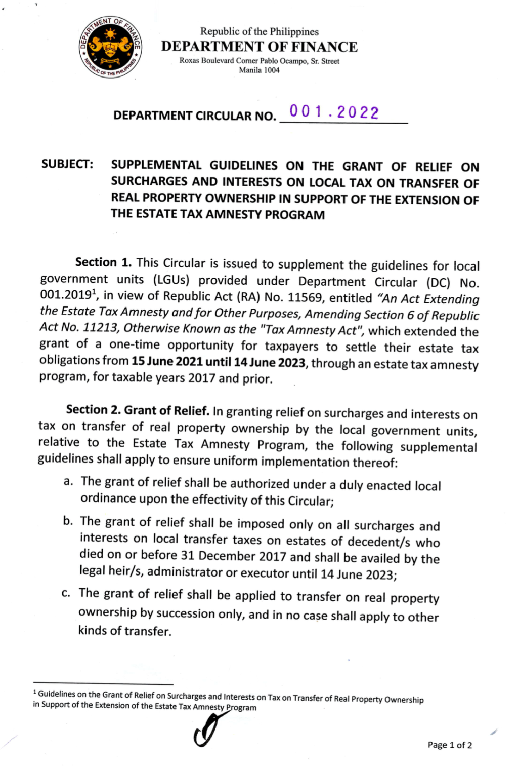
The BLGF
MEMORANDUM CIRCULAR NO. 010.2022
DOF Department Circular No. 001.2022
In the grant of relief on surcharges and interests on tax on transfer of real property ownership in support of the Extension of the Estate Tax Amnesty Program, the following guidelines shall apply:
The grant of relief shall be authorized under a duly enacted local ordinance upon the effectivity of the Circular;
The grant of relief shall be imposed only on all surcharges and interests on local transfer taxes on estates of decedent/s who died on or before 31 December 2077 and shall be availed by the legal heir/s, administrator or executor until 14 June 2023;
The grant of relief shall be applied to transfer on real property ownership by succession only, and in no case shall apply to other kinds of transfer.
Notes:
This MC was issued on 24 March 2022, disseminating DOF DC No. 001.2022 dated 07 March 2022, which supplemented the guidelines for LGUs provided under DC No. 001.2019, in view of RA No. 11569, entitled “An Act Extending the Estate Tax Amnesty and for Other Purposes, Amending Section 6 of RA No. 11213, Otherwise known as the “Tax Amnesty Act”, which extended the grant of one-time opportunity for taxpayers to settle their estate tax obligations from until 14 June 2023, through an estate tax amnesty program, for taxable years 2017 and prior.
In the said DOF Department Circular, granting relief on surcharges and interests on tax on transfer of real property ownership, the following guidelines shall apply:
The grant of relief shall be authorized under a duly enacted local ordinance upon the effectivity of the Circular;
The grant of relief shall be imposed only on all surcharges and interests on local transfer taxes on estates of decedent/s who died on or before 31 December 2077 and shall be availed by the legal heir/s, administrator or executor until 14 June 2023;
The grant of relief shall be applied to transfer on real property ownership by succession only, and in no case shall apply to other kinds of transfer.
Any LGUs here started adopting and implementing this estate tax amnesty?
…

Slide 6
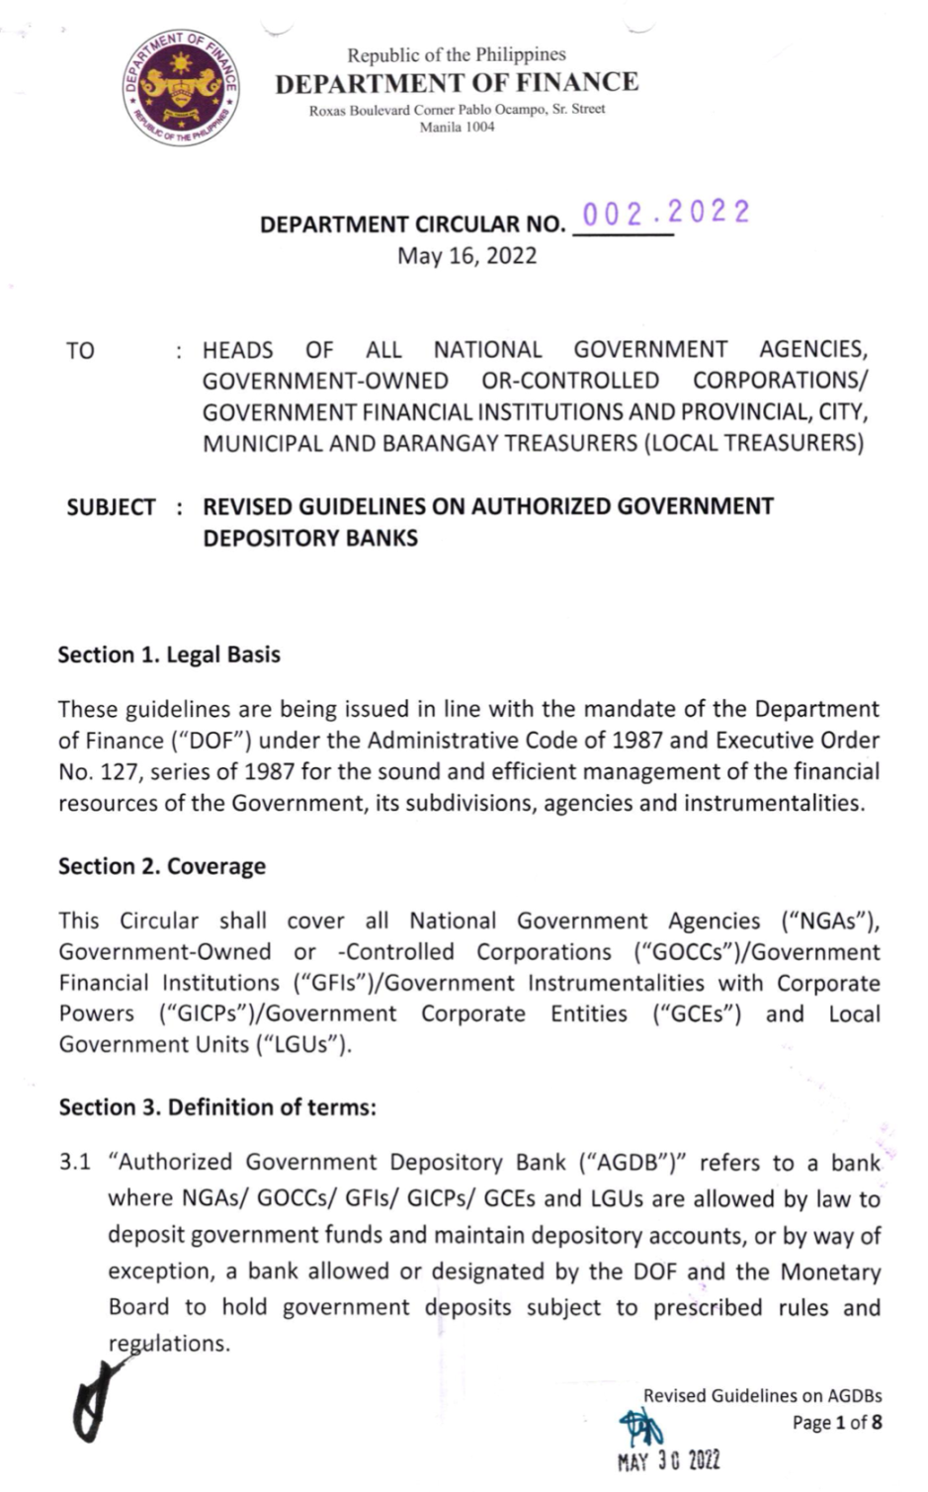
The BLGF
MEMORANDUM CIRCULAR NO. 011.2022
DOF Department Circular No. 002.2022: Revised Guidelines on Authorized Government Depository Banks
LGUs, specifically allowed by laws, rules, and regulations to retain income and/or for operations and/or working balances, shall deposit and maintain Government Funds with any of the following banks, without the need for prior approval from the Executive Director of the BLGF:
Land Bank of the Philippines;
Development Bank of the Philippines;
Overseas Filipino Bank (formerly, Philippine Postal Savings Bank Inc.); and
Al Amanah Islamic Investment Bank of the Philippines.
Notes:
With the objective to consolidate resources of in This MC was issued on 14 June 2022, disseminating DOF DC No. 002.2022 dated 16 May 2022, setting the revised guidelines on Authorized Government Depository Banks directed to the heads of All National Government Agencies, Government-Owned or –Controlled Corporations/Government Financial Institutions, and Provincial, City, Municipal, and Barangay Treasurers.
LGUs, specifically are allowed by laws, rules, and regulations to retain income and/or for operations and/or working balances, shall deposit and maintain Government Funds with any of the following banks, without the need for prior approval from the Executive Director of the BLGF:
Land Bank of the Philippines;
Development Bank of the Philippines;
Overseas Filipino Bank (formerly, Philippine Postal Savings Bank lnc.); and
Al Amanah lslamic lnvestment Bank of the Philippines.
ln highly exceptional cases, where the LGUs deemed it necessary to transact with private banks or avail its services, the LGUs shall secure the approval of the Executive Director of the BLGF.

Slide 7
The BLGF
MEMORANDUM CIRCULAR NO. 011.2022
DOF Department Circular No. 002.2022: Revised Guidelines on Authorized Government Depository Banks
To remove revenue and expenditure floats:
The LGUs may engage the collection services of banks other than those listed in the previous slide, thru a transaction fee-based arrangement, subject to the prior approval of the Executive Director of the BLGF.
Notes:
On revenue and expenditure floats, it is provided that the proposed bank will only serve as a collection bank for the account of LGUs: Provided, further that, all collections of collection banks shall be transferred to any of those listed in previous slide on the next banking day counted from the date of collection.

Slide 8
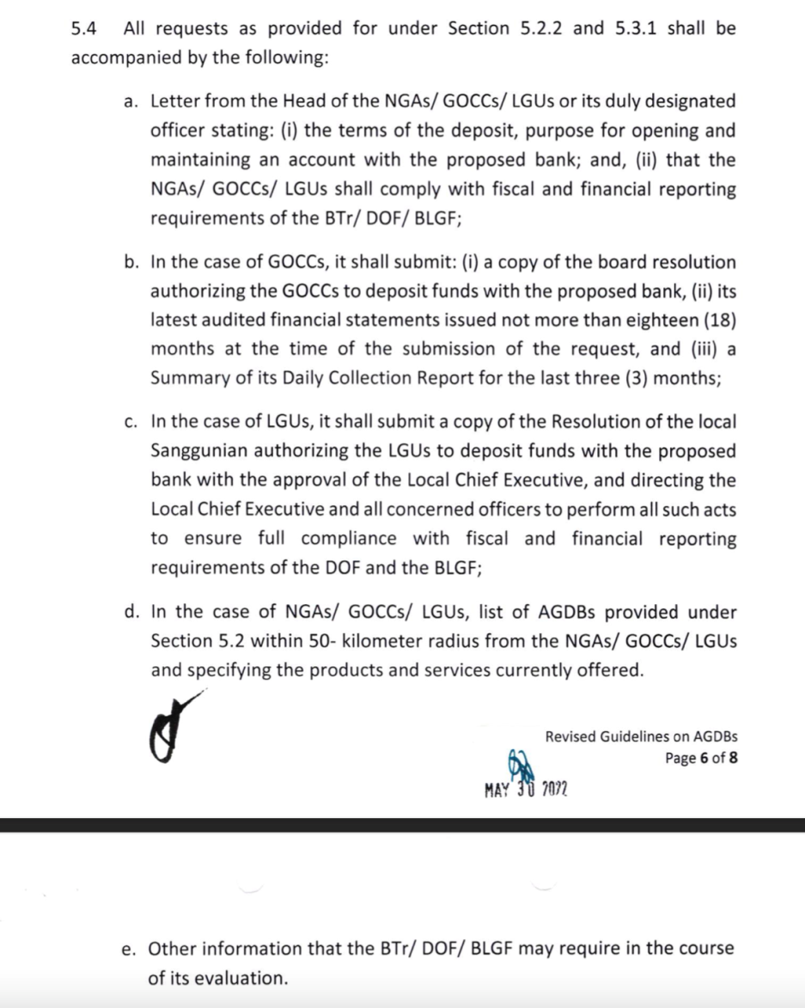
The BLGF
MEMORANDUM CIRCULAR NO. 011.2022
DOF Department Circular No. 002.2022: Revised Guidelines on Authorized Government Depository Banks
Letter from the Head of the LGU stating:
the terms of the deposit, purpose for opening and maintaining an account with the proposed bank; and
that the LGU shall comply with fiscal and financial reporting requirements of the BLGF;
Copy of the Resolution of the local Sanggunian authorizing the LGU to deposit funds with the proposed bank;
list of AGDBs, within a 50- kilometer radius from the LGU
Other information that the BLGF may require.
Notes:
All requests relative to cases where LGUs deemed it necessary to transact with private banks or avail its services, shall be accompanied by the following:
Letter from the LCE or its duly designated officer indicating:
the terms of the deposit, purpose for opening and maintaining an account with the proposed bank; and
that the LGU shall comply with fiscal and financial reporting requirements of the BLGF;
2. Copy of the Approved Resolution of the local Sanggunian authorizing the LGU to deposit funds with the proposed bank with the approval of the Local Chief Executive, and directing the Local Chief Executive and all concerned officers to perform all such acts to ensure full compliance with fiscal and financial reporting requirements of the DOF and the BLGF;
3. The LGU shall also submit a list of AGDBs, within a 50- kilometer radius from the LGU and specifying the products and services currently offered.
4. Other information that the BLGF may require in the course of its evaluation.

Slide 9
The BLGF
MEMORANDUM CIRCULAR NO. 011.2022
DOF Department Circular No. 002.2022: Revised Guidelines on Authorized Government Depository Banks
All LGUs maintaining accounts, including term deposits and investments with banks other than those listed in this DC, including those with prior BLGF approval, shall have one (1) year from the effectivity of this circular to transfer all funds and cash balances to any banks listed in this DC.
Moreover, the LGUs with existing accounts with banks other than those listed in this DC as of the effectivity of this Circular, shall, for purposes of amortization payment only, be allowed to maintain such accounts until the loan maturity.
Notes:
All LGUs maintaining accounts, including term deposits and investments with banks other than those listed in this DC, including those with prior BLGF approval, shall have one (1) year from the effectivity of this circular to transfer all funds and cash balances to any banks listed in this DC.
Moreover, the LGUs with existing accounts with banks other than those listed in this DC as of the effectivity of this Circular, shall, for purposes of amortization payment only, be allowed to maintain such accounts until the loan maturity.

Slide 10
The BLGF
MEMORANDUM CIRCULAR NO. 011.2022
DOF Department Circular No. 002.2022: Revised Guidelines on Authorized Government Depository Banks
Lastly, the LGUs with existing term deposits and investments in treasury bills, bonds and other instruments with banks other than those listed in this DC are not allowed to renew or extend the maturity periods of such deposits and investments upon the effectivity of this Act.
Notes:
Lastly, the LGUs shall immediately transfer the proceeds from such deposits and investments to any banks listed in this DC upon their maturity. This is without prejudice to those term deposits and investments in treasury bills, bonds, and other instruments maturing beyond the one (1) year transitory period.
On the Issue of the Philippine Veterans Bank being authorized under RA 11597. The management of PVB is now in consultation with the Bangko Sentral ng Pilipinas and the Department of Finance with the request for the amendment of this Department Circular.

Slide 11
MEMORANDUM CIRCULAR NO. 003.2022
DOJ Opinion on Section 15 (c) of RA No. 9513
Section 15(c) of the Renewable Energy Act, the special realty imposed on Renewal Energy developers for real properties, actually and exclusively used for Renewal Energy facilities should not exceed 1.5%, which rate includes the basic RPT and the additional levy for SEF.
Notes:
This BLGF Memorandum Circular No. 003.2022 was issued on January 10, 2022, regarding the proper interpretation and application of Section 15 (c) of RA No. 9513, or the Renewable Energy Act of 2008, on the levy and collection of realty and other taxes in relation to RA No. 7160 or the Local Government Code (LGC) of 1991.
The said DOJ Opinion stated that additional levy imposed under Section 235 of the LGC is a tax, and as such, is included in the term “realty and other taxes” referred to in Section 15(c) of the RE Act. Even assuming hypothetically that the additional levy which accrues to the SEF cannot be considered as a realty tax, it may nevertheless be considered as a specie of "other taxes", and thus remains within the ambit of the phrase "realty and other taxes" in Sec 15(c) of the RE Act. As such, it should not exceed 1.5% which rate includes the basic RPT and additional levy for SEF.
Site Example of Matrix

Slide 12
The BLGF
MEMORANDUM CIRCULAR NO. 004.2022
Advisory on the Assessment, Collection, and Payment of Local Business Tax, Other Taxes, Fees and Charges Under the New Normal
1. Administrative actions that may be instituted in accordance with existing rules and regulations, and appropriate internal controls, such as:
Implementation of online assessment and collection systems;
Establishment of physical and/or electronic Business One-Stop Shops (BOSS);
Installation of manual or electronic kiosks;
Establishment of satellite or mobile assessment hubs and collection centers in barangays, or extensions of physical BOSS;
Notes:
This MC was issued on 17 January 2022, to guide all local treasurers in managing the effect of the recent Covid-19 surge, relative to their operations under the new normal in the assessment, collection and payment of local business tax (LBT), other taxes, fees and charges.
Consistent with the objectives of DOF Department Circulars No. 02.2020 dated 23 April 2020 and DC No. 03.2020 pursuant to Bayanihan to Heal as One act, DILG Advisory dated 24 December 2021 and ARTA-DTI-DILG-DICT Joint MC No. 01, s. 2014, all local treasurers were enjoined to adopt strategies and guidelines to facilitate taxpayers’ compliance with the deadlines for the payment of LBT, other taxes, fees and charges, especially during the business application and renewal period and the extension thereof, while following the necessary health protocols.
Administrative actions that may be instituted in accordance with existing rules and regulations, and appropriate internal controls, such as:
Implementation of online assessment and collection systems such as web-based portals, or other non-face-to-face payment facilities, including issuance of electronic statement of Account;
Establishment of physical and/or electronic Business One-Stop Shops (BOSS) - to receive and process manual and/or electronic submissions for the assessment and payment of LBT, other taxes, fees and charges;
Installation of manual or electronic kiosks - that can process applications, and assessment or payment of taxes, fees and charges, which may be located at the city/municipal hall, Negosyo Center, and other areas where businesses are mostly located;
Establishment of satellite or mobile assessment hubs and collection centers in barangays, or extensions of physical BOSS, - preferably in accessible and open-air locations, such as gymnasia, basketball courts, quadrangle, outdoor venues, open spaces, among others, where there is good ventilation and crowding will be minimized;

Slide 13
The BLGF
Memorandum Circular No. 004.2022
MEMORANDUM CIRCULAR NO. 004.2022
Advisory on the Assessment, Collection, and Payment of Local Business Tax, Other Taxes, Fees and Charges Under the New Normal
1. Administrative actions that may be instituted in accordance with existing rules and regulations, and appropriate internal controls, such as:
Adoption of cluster-/schedule-based approach;
Extension of regular business hours and/or days of the Local Treasury Office;
Cause the reconfiguration of applicable information system/s of the LGU;
Combination of any of the above approaches.
Notes:
Adoption of cluster-/schedule-based approach - for faster processing and payment of local taxes, fees and charges;
Cause the reconfiguration of applicable information system/s of the LGU - for the assessment and computation of such taxes, fees and charges, in view of the abovementioned applicable strategies, pursuant to Sec. 470(d)56 of the LGC; and
Combination of any of the above approaches, subject to the discretion of the concerned LGU and other strategies that will facilitate the efficient and safe payment of local taxes, fees and charges, given the current Covid-19 surge or similar instances.
Combination of any of the above approaches.

Slide 14
MEMORANDUM CIRCULAR NO. 004.2022
Adoption of electronic facilities for business registration and renewal.
Use the anniversary date of the business as basis for the renewal period of business permits pursuant to Section 11 (e)7 of Republic Act (RA) No. 110328.
Local treasurers are reminded to always consider the LGU's available funds and cash flow requirements and projections to ensure that funding for basic services and mandatory obligations will not be hampered.
Notes:
2. Pursuant to the directive of the Secretary of Finance urging LGUs to adopt electronic facilities for business registration and renewal, and most importantly in the assessment and collection of taxes, fees, and charges, the local treasurers of LGUs that are yet to shift to digital transactions are particularly enjoined to link with the government financial institutions (GFls) acting as depository or servicing banks of the LGUs, that already offer or provide online
payment facilities to their clientele and the general public.
3. ln case the LGU opts to use the anniversary date of the business as basis for the renewal period of business permits pursuant to Section 11 (e)7 of Republic Act (RA) No. 110328, the validity of the business permit will be for a period of one year from the date of issuance or anniversary date, instead of up to December 31 of each year only. As such, business permits issued in the preceding year shall remain valid for one (1) year from the date reflected in the Permit
4. ln advising the local chief executive and the Sanggunian concerned on the extension of the deadline of payment of LBT, other taxes, fees and charges, local treasurers are reminded to always consider the LGU's available funds and cash flow requirements and projections to ensure that funding for basic services and mandatory obligations will not be hampered.

Slide 15
The BLGF
MEMORANDUM CIRCULAR NO. 004.2022
LGUs that are not extending the payment deadlines are still enjoined to adopt the applicable strategies and actions stated thereof, as part of the new normal treasury operations during the Covid-19 pandemic and in other similar instances.
On real property tax (RPT) and Special Education Fund (SEF), Section 250 of the LGC, allows four (4) equal installments for four (4) quarters without interest or penalties: first installment to be due and payable on or before 31 March; second installment, on or before 30 June; third installment, on or before 30 September; and the last installment on or before 31 December.
Notes:
LGUs that are not extending the payment deadlines are still enjoined to adopt the applicable strategies and actions stated thereof, as part of the new normal treasury operations during the Covid-19 pandemic and in other similar instances.
As regards the payment of real property tax (RPT) and Special Education Fund (SEF), which is governed by Section 250 of the LGC, i.e., four (4) equal installments for four (4) quarters without interest or penalties: first installment to be due and payable on or before 31 March; second installment, on or before 30 June; third installment, on or before 30 September; and the last installment on or before 31 December.

Slide 16
The BLGF
MEMORANDUM
Authority to Give Overtime Payment for Service Rendered During Election Period
Disseminating the Commission on Elections (ComElec) Minute Resolution No. 19-0414 dated 30 April 2019, which authorizes the payment of overtime claim for extra services, rendered by provincial, city and municipal treasurers in connection, with the May 13, 2019 Elections and to future elections.
Notes:
The COMELEC under Resolution No. 19-0414 dated 30 April 2019 resolved that:
The Provincial, City, and Municipal Treasurers may claim overtime pay for extra services rendered during the election period as deputies of the Commission in connection with May 13, 2019 National and Local Elections, subject to COA and Civil Service rules and regulations, and payment thereof shall be charged to the local government unit concerned.
This resolution applies to future elections.

Slide 17
Department of Finance
BUREAU OF LOCAL GOVERNMENT FINANCE
Improving Local Finance, Empowering Local Governments towards Sustainability
MUNTAP@53
BEAMING EXCELLENCE BEYOND THE NEW NORMAL
RICARDO L. BOBIS, JR.
Director II, LGUOS
Davao City | 23 August 2022
Notes:
These are the latest updates from the Department of Finance and the Bureau of Local Government Finance.
For questions, you may approach me later if we do not have time for an open forum.
[Are we still good? ] ok.
Ok, then. Let me proceed with the second topic…

Slide 18
DIGITAL TREASURY:
A STRATEGIC ADVANCEMENT UNDER THE NEW NORMAL
Notes:
Digital Treasury: A strategic advancement under the new normal.
Digital transactions have actually grown substantially in recent years, or perhaps more so pronounced lately, in the Philippines as consumers ditch physical transactions and payments to avoid contact on worries over catching coronavirus.
One positive thing covid-19 provided us is the opportunity to test our systems and institutions in our readiness for the future, for the digital economy.

Slide 19
OVERVIEW
What is the current environment when we talk of electronic and digital transactions?
Government is stepping up its efforts to promote digital transactions
Retail Oriented
Business to Government
Notes:
The Philippine government is stepping up efforts to promote digital currency and transactions.
During former President Duterte’s final state of the nation address (SONA), President Duterte said the proposed E-Governance Act (House Bill No. 3 or the E-Governance Act of 2022) will institutionalize the transition of the government to e governance amid the challenges it faced during the COVID-19 pandemic. This was also highlighted by the now President Marcos during his first SONA, by laying out his administration’s priority bills, including the e-governance act.
House Bill 3, or the proposed E-Governance Act of 2022, is based largely on the previously filed Senate Bill 1738, which was stuck in committee when the 18th Congress ended.
The measure mandates the government to establish an integrated, interconnected, and interoperable information and resource-sharing and communications network spanning the entirety of the national and local government; an internal records management information system; an information database; and digital portals for the delivery of public services.
It also pushes for the digitization of paper-based and other traditional modes of workflows for a more efficient and transparent public service.
Former Finance Secretary Dominguez also underscored the importance of switching to electronic governance (e-governance) to cut red tape, upgrade the delivery of services to the people and curb corruption in the government.
Moreover, the introduction of EGov Pay which is a digital payment platform for administrative services launched by the government in November 2019. The government also plans to make the new National QR Code Standard, which was introduced along with EGov Pay facility in partnership with the public and private-sector banks, usable commercially by the end of the year.
Focus on Retail Orientation of electronic and digital payment systems has also led to improvements in the regulatory and policy front, such as the pesonet and instapay. These existing electronic payment system may be used/adopted by LGUs in the design of their EPCS.
On Business to Government, National Government Agencies (BIR, Government Electronic Procurement System, Government Electronic Payment and Collection Systems) have been successful, and a number of LGUs are already going there, which will be the subject of my succeeding slides.
According to the BSP Digital Payments Transformation Roadmap, while digital business tax payments have risen significantly due to the mandatory use of the Electronic Filing and Payment System by big businesses, statistics shows that only 1% of payments of taxes and fees to LGUs are made through digital means.
Adoption of such measure can significantly save business cost, time and effort. As such the transfers of funds that covers payment of taxes, fees, loan amortizations and social welfare contributions, representing a key area for potential growth in digital payments.
Various LGUs are currently at different levels of readiness in terms of being able to accept digital payments, and there is a need for stronger coordination among agencies to increase their capacity for the adoption of the said digital payment systems.
On the regulatory and policy front, two initiatives implemented since the 2015 diagnostic have established a bedrock for payment systems in the country. The National Retail Payment System (NRPS), launched in 2015. Under the NRPS, the BSP helped create two Automated Clearing Houses (ACH), namely:
PESONet, launched in November 2017 and
InstaPay, launched in April 2018, allows fund transfer between any two accounts in the country. Financial institutions are mandated to offer fund transfers through these Automated Clearing Houses (ACHs), thus enabling interoperability between accounts. By the end of 2018, the measurement period of this study, PESONet and InstaPay had only been operating for a few months. Payment volumes under InstaPay and PESONet make up a small share (0.02%) of all payments but continue to grow month-on-month and offer potential to increase the penetration of digital payments even further

Slide 20
LEGAL BASES
Republic Act (RA) No. 8792: e-Commerce Act
14 June 2000 – Sec. 27, Sec. 28
DOF and DTI Joint Department Administrative Order (JDAO) No. 02, Series of 2006 – policies and guidelines in adopting EPCS in the government
Commission on Audit (COA) Circular No. 2013-007
Notes:
As far back as 20 years ago with the enactment of the eCommerce Act, the principles for the adoption of key operational concepts for electronic payment system, has been laid down.
Sec. 27 of the eCommerce act provides that all government agencies and government owned and controlled corporations shall:
accept the creation, filing or retention of such documents in the form or electronic data messages or electronic documents;
issue permits, licenses, or approval in the form of electronic data messages or electronic documents;
require and/or accept payments, and issue receipts acknowledging such payments, through systems using electronic data messages or electronic documents; or
transact the government business and/or perform governmental functions using electronic data messages or electronic documents, and for the purpose, are authorized to adopt and promulgate, after appropriate public hearing and with due publication in newspapers of general circulation, the appropriate rules, regulations, or guidelines
Sec. 28 of the same act deals with the promotion on the use of Electronic Documents or Electronic Data Messages in Government and to the General Public to facilitate the open, speedy and efficient electronic online transmission, conveyance and use of electronic data messages or electronic documents amongst all government departments, agencies, bureaus, offices down to the division level and to the regional and provincial offices as practicable as possible, government-owned and controlled corporations, local government units, other public instrumentalities, universities, colleges and other schools, and universal access to the general public.
The issuance of the Joint Department Administrative Order in 2006 prescribes the policies and guidelines in the adoption of EPCS in government transactions which primarily aimed to bring a more efficient and effective payment and collection services thru the use of EPCS, in order to allow the government to better manage its financial resources for an improved revenue generation capability.
Sec. III Objective
The Joint Order is issued to prescribed policies and guidelines in the adoption of Electronic Payment and Collection System (EPCS) in the government.
The guidelines are expected to bring about more efficient and effective payment and collection services for transacting clients and amongst the government offices thru any authorized EPCS allowing the government to better manage its financial resources, thereby improving its revenue generation capability.
Sec. V Scope of the JDAO which provides that all the provision provided shall apply to all government entities that intend to use or which have existing Electronic Payment and Collection Systems (EPCS) for the collection of fees, charges, assessment and revenues.
The EPCS should be able to accommodate various modes and channels of electronic payments such as but not limited to credit cards, ATMs, debit cards, stored value cards, mobile wallet payments and kiosks.
COA circular No. 2013-2007 highlights the emerging need of electronic collections system and recognizes the use of electronic official receipts (eORs) to acknowledge collection of Income and other receipts of Government.
Sec 3. of COA Circular NO. 2013-2007 provides the general guidelines in the use of the eOR and the acknowledgement of collections, to wit:
3.1 All collections shall be acknowledged by the government agency concerned thru the issuance of Official Receipts to established that this has been received.
3.2 Receipt of collection/revenues thru electronic means shall be acknowledged by an eOR
3.4 Collections of National Government Agencies (NGAs) shall be deposited to the account of the Treasurer of the Philippines. Collection of Local Government Units (LGUs) and of the Government Owned and Controlled Corporation (GOCC) shall be deposited to their respective accounts in the designated AGDBs.

Slide 21
COVID-19 CONTEXT
RA No. 11469: Bayanihan to Heal as One Act
RA No. 11494: Bayanihan to Recover as One Act
DOF Department Circular Nos. 002-2020, 003-2020: Extension of Deadlines for the Payment of Taxes, Fees and Charges of LGUs
Issued in view of the disruption of the severe disruption of economic activities brought about by the COVID-19
Protect the interest of the taxpayers in view of the challenging times
To enable the use or adoption of electronic or non-face to face payment facilities to ensure physical distancing
Notes:
The COVID-19 pandemic in 2020 amplifies the need of embracing the EPCS.
The onset of COVID-19 that resulted in the impositions of lockdowns has crippled the Philippine economy. Stringent social distancing measures and quarantines restricted the mobility of people, thus significantly affecting livelihood.
The enactment of RA 11469 provides for a more intensified response to bring about full assistance to LGUs and mobilize the necessary response to curtail the financial burden of majority of the Filipinos.
Subsequently, subsidies to the most vulnerable sector were provided. At this point, the need for the EPCS has been amplified.
Several LGUs, particularly in the NCR have intensively campaigned and use the EPCS as a tool for the payout.
Sec. 4 c. of RA 11469 states that there shall be provided an emergency subsidy to around 18 million low-income households, provided that the subsidy shall amount to a minimum of Php5,000.00 to a maximum of Php8,000.00 xxx
Sec. 4 g. states that LGUs must ensure that it shall act within the letter and spirit of all the rules and regulations and directives issued by the National Government pursuant to this Act; are implementing standards of community quarantine consistent with what the National Government has laid down for the subject area, while allowing LGUs to continue exercising their autonomy in matters undefined by the National Government or are within the parameters it has set; and are fully cooperating towards a unified, cohesive and orderly implementation of the national policy to address COVID-19 xxx
RA 11494, continues the implementation of financial provisions that serves as interventions to aid in the recovery of affected Filipinos. Now more than ever the convenience the EPCS in the financial dole out has been highlighted:
Sec. 2 a. Reduce the adverse impact of COVID-19 on the socio-economic well-being of all Filipinos thru the provision of assistance, subsidies and other forms of socio economic relief.
Sec. 4 f1. An emergency subsidy of Php5,000.00 to Php8,000.00 pesos to the affected low- income households in the areas under the granular lockdown and to the household with recently returned OFW xxx
Sec. 4 f3. xxx Any subsidy program shall as far as practicable be implemented thru a social protection distribution system that embeds secure and privacy preserving data capture, verification, deduplication, payroll generation, grievance and payout using digital technologies. For this purpose the payment of necessary transaction fees for the last mile delivery of subsidies to qualified beneficiary is hereby authorized.
Meanwhile, the DOF in response to supplement the provisions as provided in the Bayanihan Law has issued DOF Circulars directing LGUs to consider the welfare of its taxpayers during the pandemic by not only providing extensions to deadlines for the payments of taxes but also by encouraging LGUs to adopt the EPCS to minimize physical contact
DOF Department Circular No. 002-2020
Sec. 4. Mandatory Extension of Deadline for the Payment of Taxes, Fees and Charges imposed and Collected by the LGUs. The deadline for the payment of all local taxes, fees and charges, duly authorized and imposed by the LGUs within their respective territorial jurisdictions as of 25 March 2020 shall be extended until 25 June 2020. Further, the counting period within which to pay local taxes, fees and charges shall likewise be suspended during the said period. xxx
Sec. 7 Roles and Responsibilities:
7.1 All local treasurers, in coordination with concerned local officials, shall:
7.1.1 Actively and widely inform the taxpayers of the extension of deadlines of payment of local impositions thru various platforms
7.1.2 Cause the reconfiguration of electronic information system used by the LGU concerned for the assessment of and computation of such local taxes, fees and charges xxx
7.1.3 Enable the use of electronic or non-face to face payment facilities so that any taxpayer who still opt to pay may be accommodated to ensure social/physical distancing
DOF Department Circular 003-2020
Sec. 3. Mandatory Extension of Deadline for the Payment of Taxes, Fees and Charges imposed and Collected by the LGUs. The deadline for the payment of all local taxes, fees and charges, duly authorized and imposed by the LGUs within their respective territorial jurisdictions, that fall on or after 14 September 2020 shall be extended until 19 December 2020xxx
Sec. 6 Roles and Responsibilities:
6.1 All local treasurers, in coordination with concerned local officials, shall:
6.1.1 Actively and widely inform the taxpayers of the extension of deadlines of payment of local impositions thru various platforms
6.1.2 Cause the reconfiguration of electronic information system used by the LGU concerned for the assessment of and computation of such local taxes, fees and charges xxx
6.1.3 Enable the use of electronic or non-face to face payment facilities so that any taxpayer who still opt to pay may be accommodated to ensure social/physical distancing
6.1.4. Consistent with RA 8792 or the eCommerce Act, JADO 02 s 2006 of the DOF-DTI and COA Circular No. 2013-07, work on immediate adoption of digital or electronic facilities for the assessment and collection of local taxes, fees and charges and to ensure safe convenient and efficient transactions with the local treasury office.

Slide 22
QUICK SURVEY ON EPCS
Online/Electronic Payment Facilities of LGUs
The BLGF surveyed 1,702 LGUs:
Provinces
81 or 100%
Cities
145 or 99.32%
Municipalities
1,476 or 99.86%
Notes:
ln line with the BLGFs continuing thrust to study existing policies and updating of baseline information on the payment schemes of local government units (LGUs) for the collection of local taxes, fees and charges, and other impositions, aa survey has been administered to determine the extent of use of information and communication technology (lCT) in local treasury operations, particularly on electronic payment and collection system (EPCS).
Out of the 1,715 LGUs a total of 1,702 have responded to the survey or a total compliance rate of 99.3%
The survey was broken down per LGU type and gained 81 or 100% response from the provinces, 145 or 99.32% of the cities, and 1,476 or 99.86% of the municipalities have successfully complied.

Slide 23
QUICK SURVEY ON EPCS
Survey Respondents
LGU Type | EPCS |  | Total
LGU Type | Yes | No | Total
Provinces | 6 | 75 | 81
Cities | 45 | 100 | 145
Municipalities | 62 | 1414 | 1,476
TOTAL | 113 | 1,589 | 1,702
Notes:
The result of the survey provides a clearer picture on the use/adoption of EPCS in the LGU sector.
Out of the 81 provinces that responded, the survey shows that only 6 or 7.41% of the Provinces are actually using EPCS.
For the cities, out of the total of 145 responses, only 45 or 31.03% of the cities utilize the EPCS.
Lastly, only 61 out of 1,476 respondents or 4.13% of the municipalities from various regions disclosed that they are using EPCS.

Slide 24
EPCS USED BY LGUS
Notes:
The following are the EPCS facilities used by the LGUs: (look at screen)
The survey was narrowed down to the most common digital/payment platform being utilized by the LGUs that concerns the collection of revenues, charges and regulatory fees. The numbers represent the use/adoption of these digital/payment services. It is noteworthy to mention that some LGUs are utilizing a combination of these digital/platforms as reflected in the survey
The Land Bank of the Philippines, an Authorized Government Depository Bank (AGDB), is being the prime choice of majority of the LGUs that participated in the survey
Other notable and established EPCS platforms that are being utilized by the surveyed LGUs are:
Interbank network BancNet
Visa/Mastercard Debit and Credit
On-line payment system PayMaya and
GCash

Slide 25
CHALLENGES, CONSTRAINTS
Binding Constraints on a Macro Perspective
Culture
Are most Filipinos ready for digital transactions?
ICT Infrastructure
Notes:
Are most Filipino ready for digital transactions?
Malacañang expressed confidence that the government is ready to transform the Philippines into a “cashless” society, given that the country is still grappling with the Covid-19 pandemic. A survey conducted by MoneyTransfers.com, an international money transfer firm, found that Philippines ranked 8th in the list of countries that favor a cashless society.
A recent study by Visa Philippines called “Consumer Payment Attitudes,” have shown Filipinos to be generally interested in cashless transactions thru the use of electronic transfers of money, credit and debit cards, mobile wallets and on-line transfers.
While the preferred manner of payment is still cash, the study finds that most consumers, who already use traditional credit cards, are likely to try other contactless payment methods. Nearly 4 out of 5 respondents said they are willing to give it a go, citing convenience, speed, and “an innovative way to pay” as motivations.
ITC Infrastructure
The BSP sees strong potential in the use of satellite communications technology in delivering internet connectivity. This is being explored as a potential solution for improved financial access particularly in hard-to-reach rural areas. Toward this end, the BSP is supporting the following proposed reforms to support or may pave the way to digital financial transactions, to wit:
Open Access in Data Transmission Act. The bill aims to modernize the country’s telecoms regime which is still governed by a law that was enacted at a time when internet and data services were not yet commercially available. Among others, a major amendment of the proposed bill is to remove the requirement to obtain congressional franchise and streamline the registration process to open up the broadband industry to more players and attract much needed investment in data transmission infrastructure.
Amendment to Executive Order (EO) No. 467. Signed by former President Fidel V. Ramos as a national policy for the operation and use of international satellite communications in the country, the EO is found to be restrictive as it only allows enfranchised entities duly authorized by the National Telecommunications Commission (NTC) to access international satellite systems. The amendment aims to liberalize access to satellites for internet connectivity which will help address digital infrastructure gap in the countryside.
Such intervention/s or policies definitely pave the way for the future as Filipinos to embrace cashless transaction that is now a necessity in these trying time.

Slide 26
CONCLUSION, WAY FORWARD
The way to go is to harness ICT in modernizing payment and collection system of LGUs and adopting the necessary control measures as capacity varies in different levels, areas
Current laws and regulations provide the enabling environment for the LGUs
The current Covid-19 situation amplifies the need to adopt digital platforms
Supply is there and ECPS may be provided as standalone or add-on service
Notes:
LGUs must see the advantages in using on-line payments
The shift from the traditional mode of over-the-counter transactions to online transaction has been long urged by the Government to speed up the transactions made to Government entities and agencies by the people. There are already legislations and mechanisms laid out. It is now up to the LGU to adopt an on-line payment systems for a more efficient collection and payment system.
EPCS features mainly the convenience it may provide for taxpayers by reducing physical transactions.
COVID-19 has increased demand for eCommerce in the Philippines. While the younger population was already open to online shopping, the need for social distancing has pushed the cash centric and face to face shopping culture towards a more digital one, and this is expected to continue. What is lacking is proper digital and logistics infrastructure to truly enable a digital economy. There needs to be higher bandwidth capacity to service the retail market.
GFIs, particularly the AGDBs is at the forefront of providing LGUs with EPCS. They have the capacities and are in the position to help LGUs move towards digitized transactions to reduce contact, impede further contagion and boost economic activity as the country continues to battle the COVID-19 pandemic.
COA should provide additional guidelines on the issuance of eReceipts for LGUs as the COA Circular 2013-007 guidelines mainly focuses on the National Government Agencies.
The DOF thru the BLGF is currently encouraging LGUs to embrace and switch to digital technologies for a more improved service delivery and for an efficient collection of revenues and transactions.
Hence, we encourage LGUs through our local treasurers, to work side by side with the National Government for the adoption and widen the application of such measures to digitize our collection and payment systems, immediately.
Thank you very much!

Slide 27
THANK YOU!
@blgfph
https://blgf.gov.ph/

