Slide 1
Business Tourism: Its IMPORTANCE to LGU’s Revenue Generation
ATTY. SEDFREY L. CABALUNA
Chief Tourism Operations Officer

Slide 2
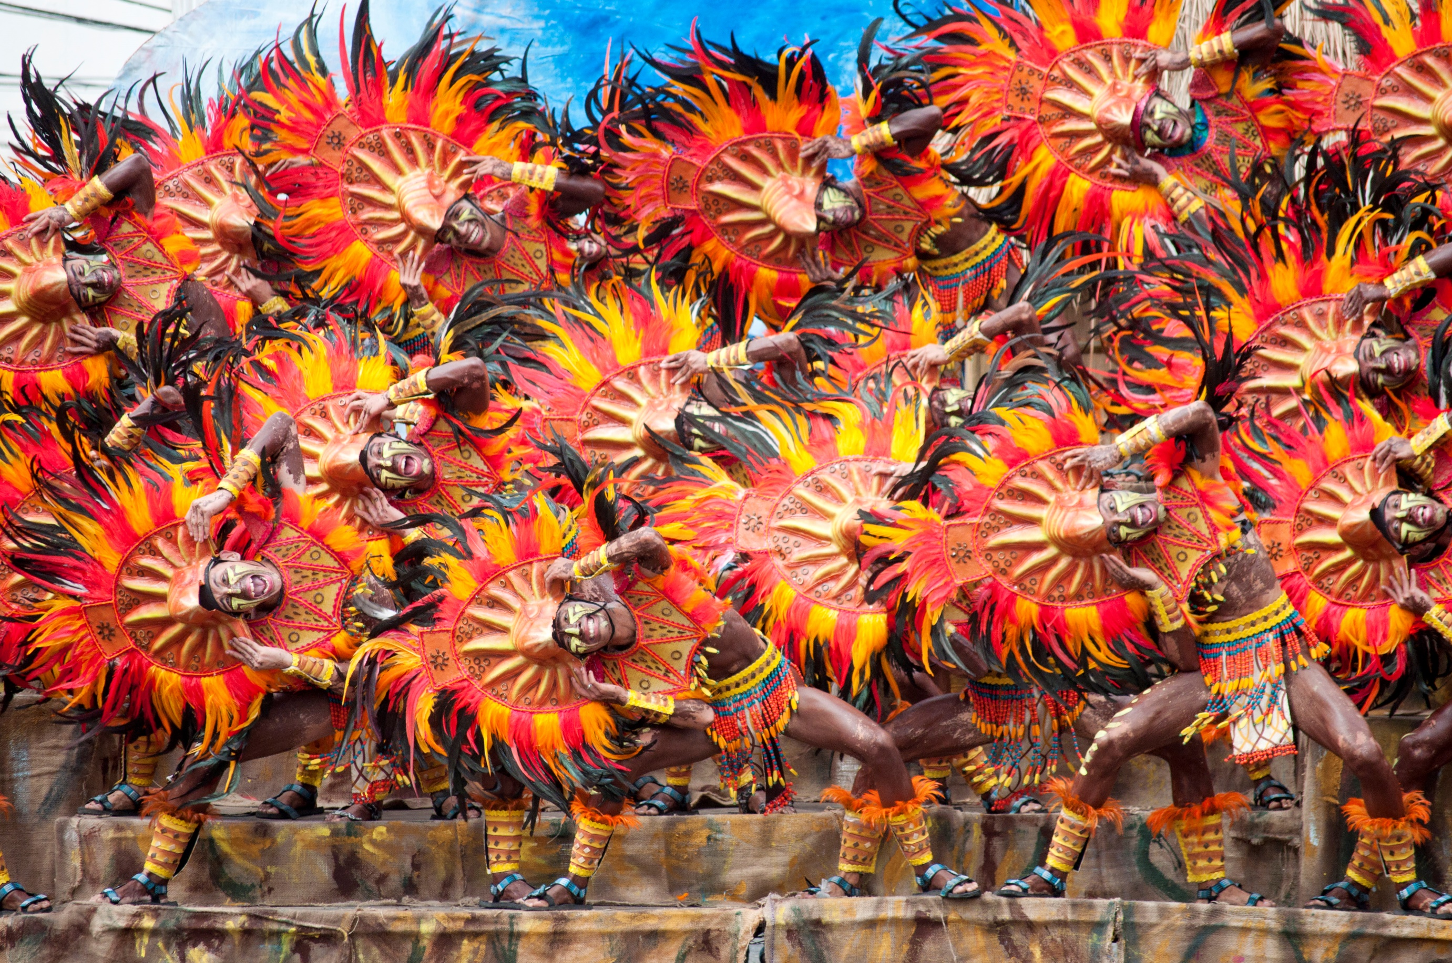
NATIONAL TOURISM DEVELOPMENT PLAN 2016-2022

Slide 3
RATIONALE
RA 9593 (Section 36)
provides for the formulation of a National Tourism Development Plan
Section 36. National Tourism Development Planning. - The Department, in coordination with its attached agencies, LGUs and the private sector, shall continuously update the existing national tourism development plan in view of evolving needs and capabilities of LGUs and the domestic and global tourism market.
Notes:
Section 36 of the Tourism Act of 2009 provides for the formulation of the National Tourism Plan to address the evolving needs of the industry.
Last February 23, 2017, the Tourism Coordinating Council (TCC), a 25-agency body established by Republic Act 9593 to coordinate national tourism development efforts, has approved the National Tourism Development Plan 2016-2022. Likewise, the Plan was presented and approved during the 14th Cabinet Meeting on 3 April 2017.

Slide 4
VISION
Position the Philippines as a premier tourist destination in Asia
MISSION
Formulate tourism plans and programs to promote, develop and regulate the country’s tourism industry as a major socio-economic activity that generates foreign currency and local employment, and to spread the benefits of tourism to a wider segment of the population with the support, assistance, and cooperation of both the private and public sectors.

Slide 5
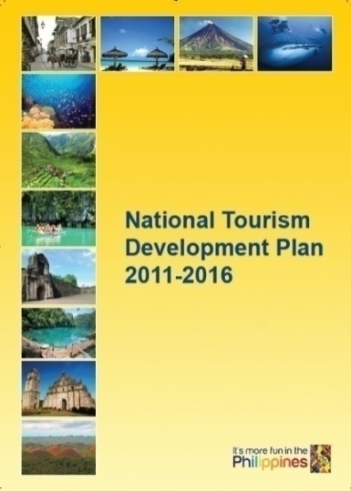
TOURISM VISION
Develop a globally competitive, environmentally sustainable and socially responsible tourism industry that promotes inclusive growth through employment generation and equitable distribution of income thereby contributing to building a foundation for a high-trust society.
2016 – 2022

Slide 6
THRUSTS
Tourism Promotion and Marketing
Tourism Standards and Services
Tourism Information, Assistance and Training
Tourism Planning and Product Development

Slide 7
NTDP GUIDING PRINCIPLES
Convergence Approach
Cluster Approach

Slide 8
CLUSTER APPROACH
Defined a logical and spatial framework by:
Linked to one or more gateways
Interdependence between TDAs
Range of destination offerings
Notes:
Two approaches were utilized as guiding principles in the formulation of the Plan.
We continue to adopt the cluster approach where we talk about developing specific areas. Together with complementing access would be the (for the most part of the Philippines):
-attendant natural and cultural attractions that we have within a certain area,
-transportation networks; and essentially,
-the urban capitals and service centers.
These Tourism Development Areas are interdependent with each other, offering a wide range of destination products, and shall be linked by one or more gateways (e.g. airports or seaports).

Slide 9
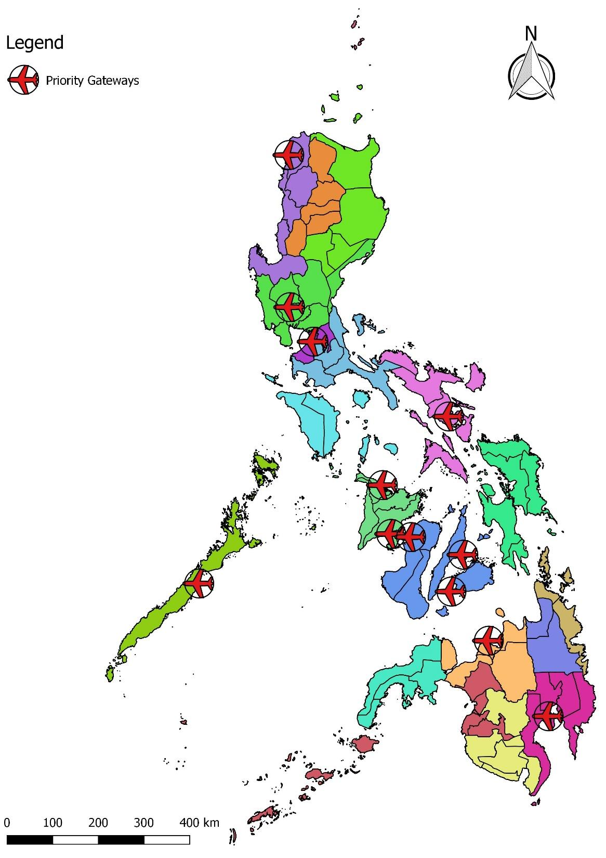
NTDP 2016-2022 TOURISM CLUSTERS AND DESTINATION AREAS
Laoag
Clark
NAIA
Bicol
20 TOURISM CLUSTERS
7 Northern Philippines
6 Central Philippines
7 Southern Philippines
of which 9 are Gateway Clusters
(with international airports)
49 TOURISM DEVELOPMENT AREAS
Kalibo
Iloilo
Cebu
Bacolod
Puerto Princesa
Bohol
Laguindingan
Davao
Notes:
With the physical framework that we have been working on, 20 Tourism Clusters composed of 49 specific Tourism Development Areas have been identified in the Plan.
-7 in Northern Philippines ranging from CAR to CALABARZON
-6 in Central Philippines comprised of MIMAROPA to Eastern Visayas; and
-7 in Southern Philippines. Zamboanga Pensinsula to ARMM
9 of these 20 are gateway clusters, which have international airports

Slide 10
CENTRAL PHILIPPINES CLUSTERS AND AREAS Under the National Tourism Development Plan 2016-2022
CENTRAL PHILIPPINES
CP-1
BICOL
CP-2
MARINDUQUE, MINDORO AND ROMBLON
CP-3:
PALAWAN
CP-4
WESTERN VISAYAS
CP-5
CENTRAL VISAYAS
CP-6
EASTERN VISAYAS
CP1-A: Camarines Norte Camarines Sur Catanduanes
CP1-B: Albay Masbate Sorsogon
CP2-A: Marinduque
CP2-B: Romblon
CP2-C: Oriental Mindoro Occidental Mindoro
CP3-A: Calamianes Group of Islands
CP3-B: El Nido Group of Islands
CP3-C: North Main Land
CP3-D: South Main Land (Puerto Princesa)
CP4-A: Iloilo Guimaras
CP4-B: Antique Aklan Capiz
CP5-A: Cebu
CP5-B: Negros Oriental Siquijor
CP5-C: Bohol
CP6-A: Leyte Southern Leyte Biliran
CP6-B: Samar Northern Samar Eastern Samar
CP4-C: Negros Occidental

Slide 11
CONVERGENCE APPROACH
Defined a logical and spatial framework by:
Create partnerships
Ensure participatory governance
Strengthen stakeholders capacity
LGUs, DILG (PNP, ROs),
TESDA, DOT, Private Sector
Safety & Security, Cleanliness, Training,
Legislation, Culture of Tourism
LGUs, DTI (BOI & ROs),
DENR, DA, DOH, TIEZA
DSWD, DOTr (LTFRB,
Marina), DOT (TPB, ROs),
Private Sector, Cultural Agencies
Accommodation, Attractions,
Standards, Promotions
Airports, Roads, Seaports,
Travel Facilitation
DOTr, CAAP, CAB, NEDA, DPWH, DFA, DOJ, DOF,
DBM, DOT, LGUs, Private Sector
LGUs, Congress, Local Stakeholders, DOT (ROs) Other NGAs
Notes:
To successfully implement the identified development programs of the NTDP, the principles of convergence is being sought to promote strong institutional partnership thru shared responsibilities with National, Local agencies and stakeholders.

Slide 12
CONVERGENCE APPROACH
TOURISM CLUSTERS
AIRPORTS, ROADS, SEAPORTS, TRAVEL FACILITATION
ACCOMMODATION, ATTRACTIONS, STANDARDS, PROMOTIONS
SAFETY AND SECURITY, CLEANLINESS, TRAINING, LEGISLATION, CULTURE OF TOURISM
Notes:
That is saying that we have to work:
-National and local, government and private, civic and business enterprises… (click)
-With special attention given by the national agencies and LGUs to airports, roads and seaports;
-The private sector being a major player in terms of Accommodation facilities, attractions, implementing standards and marketing; and
-Back to the LGUs once more in terms of improving safety, cleanliness, sanitation, training and infusing a culture of tourism.

Slide 13
STRATEGIC DIRECTIONS AND PROGRAMS
STRATEGIC DIRECTIONS
IMPROVE COMPETITIVENESS AND ENHANCE GROWTH
Intensify transport infrastructure development
Pursue travel facilitation
Attract tourism investments and improve business environment
Expand product development
Design and implement an expanded marketing program
Enhance human resource capacity and improve service standards
Promote initiatives in embracing quality standards
PURSUE SUSTAINABILITY AND INCLUSIVE GROWTH
Support MSME development in tourism
Promote gender and women empowerment
Expand and promote cultural offerings
Preserve environment & promote climate change adaptation
Implement risks and crisis management programs
STRATEGIC PROGRAMS
Notes:
To address the concerns of the industry, two strategic directions have been identified in the NTDP:
(CLICK)-One is focused on a competitive tourism industry.
For improving competitiveness, 7 priority programs were identified, to wit improving: 1) transport infrastructure, 2) the ease of travel to the country, 3) attraction of the necessary capital to improve our products, 4) the development of existing facilities to be scattered throughout the clusters, 5) expanding our marketing efforts, 6) building our human resource capacity, and 7) improving existing standards to be able to compete in the international level.
(CLICK)-Second is undertaking certain strategic programs that will pursue sustainability of whatever development framework we undertake as well as ensure that everyone participates in the growth that ensues.
On the other hand, the second strategic direction is geared towards: 1) focusing certain resources in developing our micro small and medium scale enterprises in the tourism and travel sector, 2) promoting Gender, 3) expanding our cultural offerings, 4) preserving environment and adapting climate change measures, and finally 5) implementing programs that will mitigate risks, both natural and man-made.

Slide 14
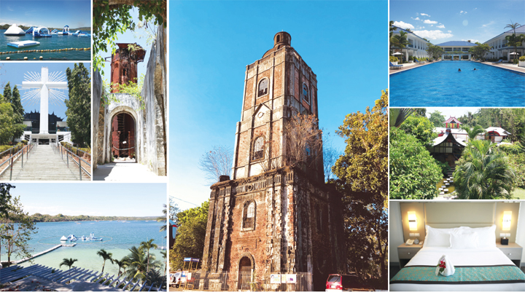
The Role of the Government and the Private Sector in the Tourism Industry
Atty. Sedfrey Cabaluna

Slide 15
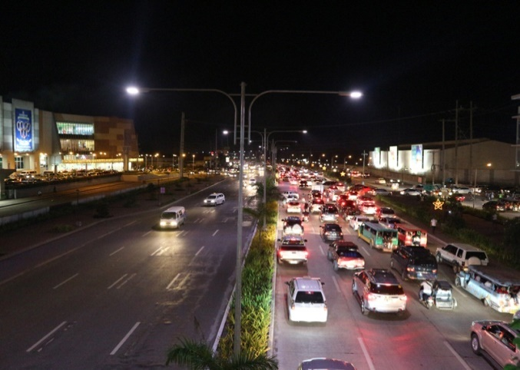
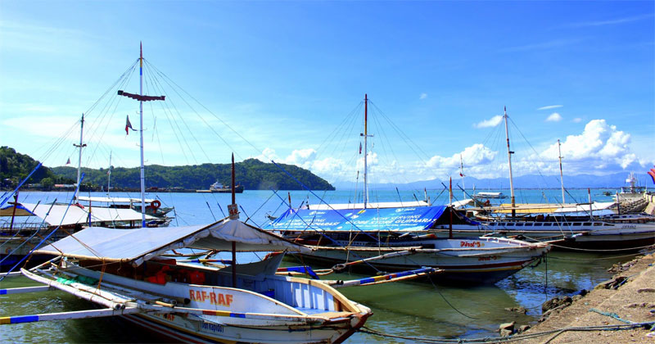
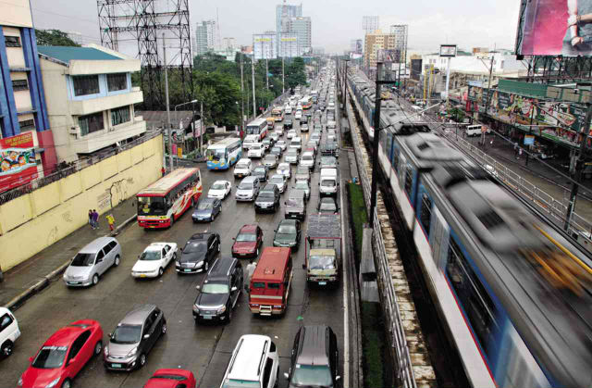
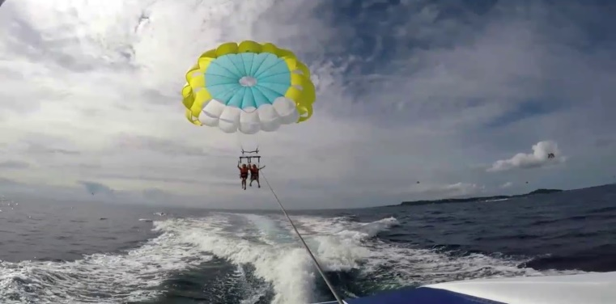
Private Sectors involved in Tourism
Transportation
(air, sea, land)
Activities
(sea sports, dive spots, discos)
Other Private Sector Entities

Slide 16
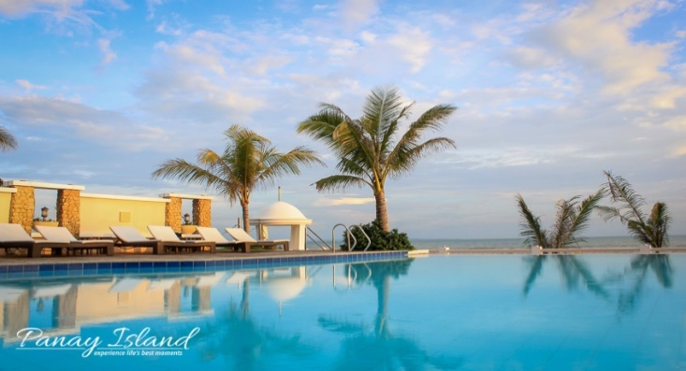
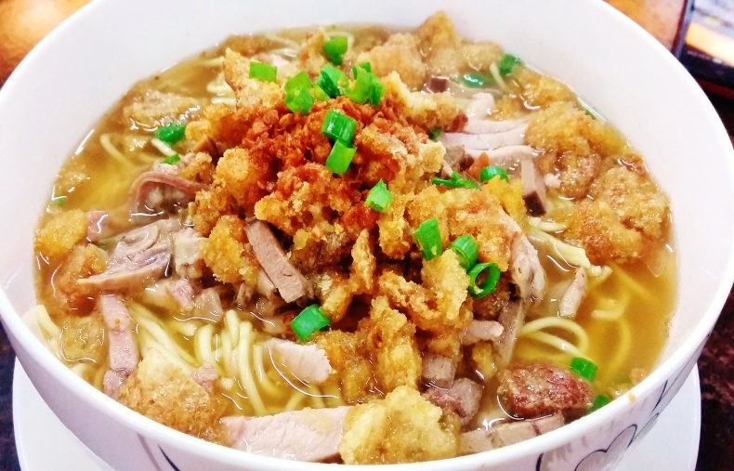
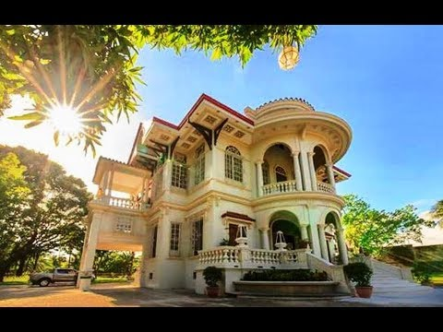
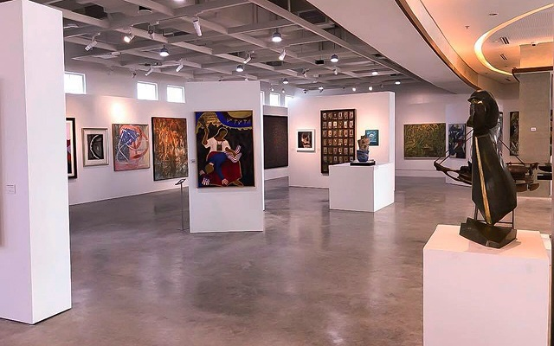
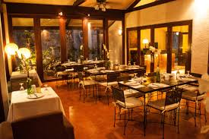
Food and Beverage
(restaurants, coffee shops, local food)
Hospitality Business
(hotels, resorts, inns etc.)
Travel and Trade
(travel agents, tour guides, tour operators)
Attraction
(museums, theme parks, restaurants)

Slide 17
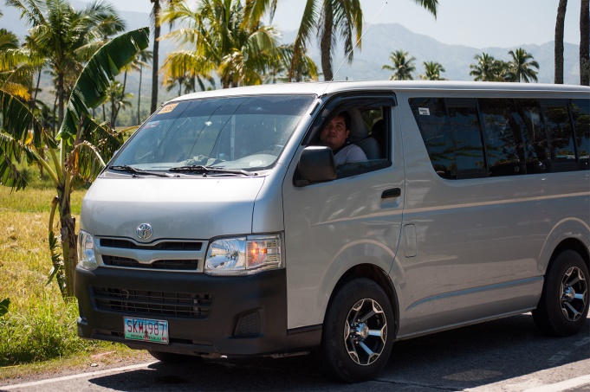
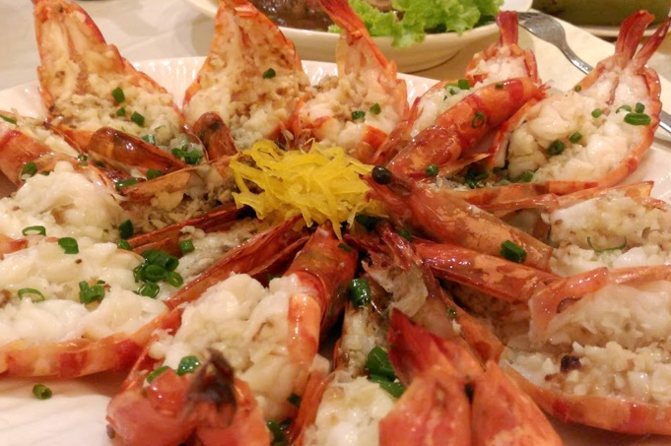
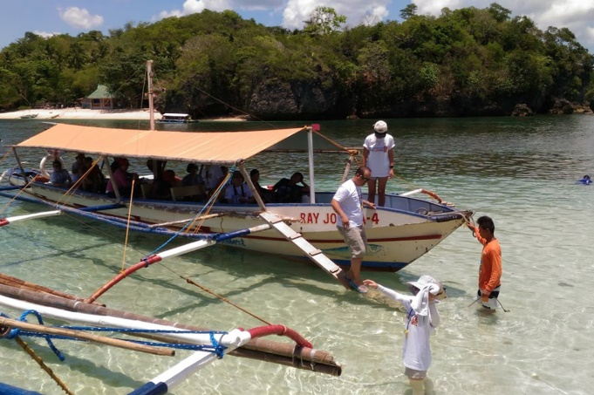
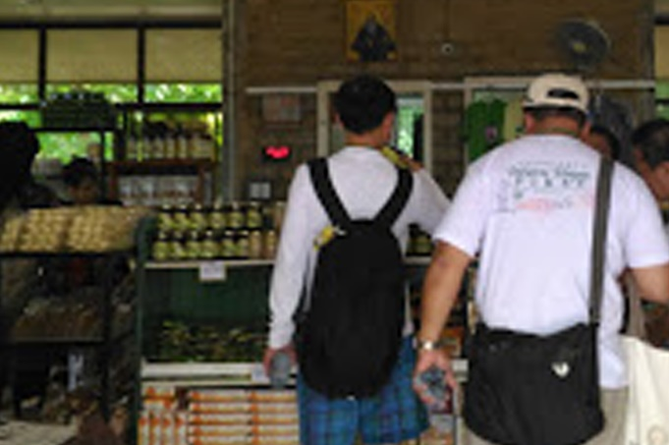
TOURISTS SPEND FOR:
Transportation
Accommodation
Food & Beverage
Miscellaneous (medical, health and wellness, etc.)
Tours
Shopping

Slide 18
The Government Sector’s Role
Responsible for the formulation of tourism policies
Provides guidelines for the development of destinations

Slide 19
The Government Sector’s Role
Regulates the industry in collaboration with other government industries

Slide 20
The private sector has to work with the government to develop plans for sustainable and profitable growth. It will have to play a pivotal role in rehabilitating and accelerating the pace of tourism development.

Slide 21
Cooper et al (1993) defines tourism as a multi dimensional activity, which touches many lives and different economic development as it interferes in a number of sectors leading to development.

Slide 22
Private sectors weighs a heavy impact on tourism development, here are things to consider:
Building and managing the required tourist facilities at all places of tourist interest.

Slide 23
What are examples of Tourist Facilities?

Slide 24
Involving the local community in tourism projects and ensuring that the benefits of tourism accrue to them in right measure.

Slide 25
Assuring collective responsibility for laying down industry standards, global code of ethics and best practices.

Slide 26
Undertaking industry training and manpower development for achieving excellence in quality of services.

Slide 27
Participating in the preparation of investment guidelines and marketing strategies and assisting in database creation and research.

Slide 28
Facilitating safety and security of tourists.
Ensuring preservation and protection of tourist attractions.

Slide 29
What is the role of the private sector in tourism planning and development?

Slide 30
Private tourism businesses can provide a forum for discussing and resolving common problems associated with tourism enterprises.

Slide 31
Private tourism businesses make coordinated recommendations to the government office for improvements in the tourism sector

Slide 32
Private tourism businesses can provide representation on tourism boards and committees

Slide 33
Private tourism businesses can conduct research, marketing and training related to the private sector

Slide 34
Private tourism businesses can sponsor special events
Private tourism businesses can work with local government

Slide 36
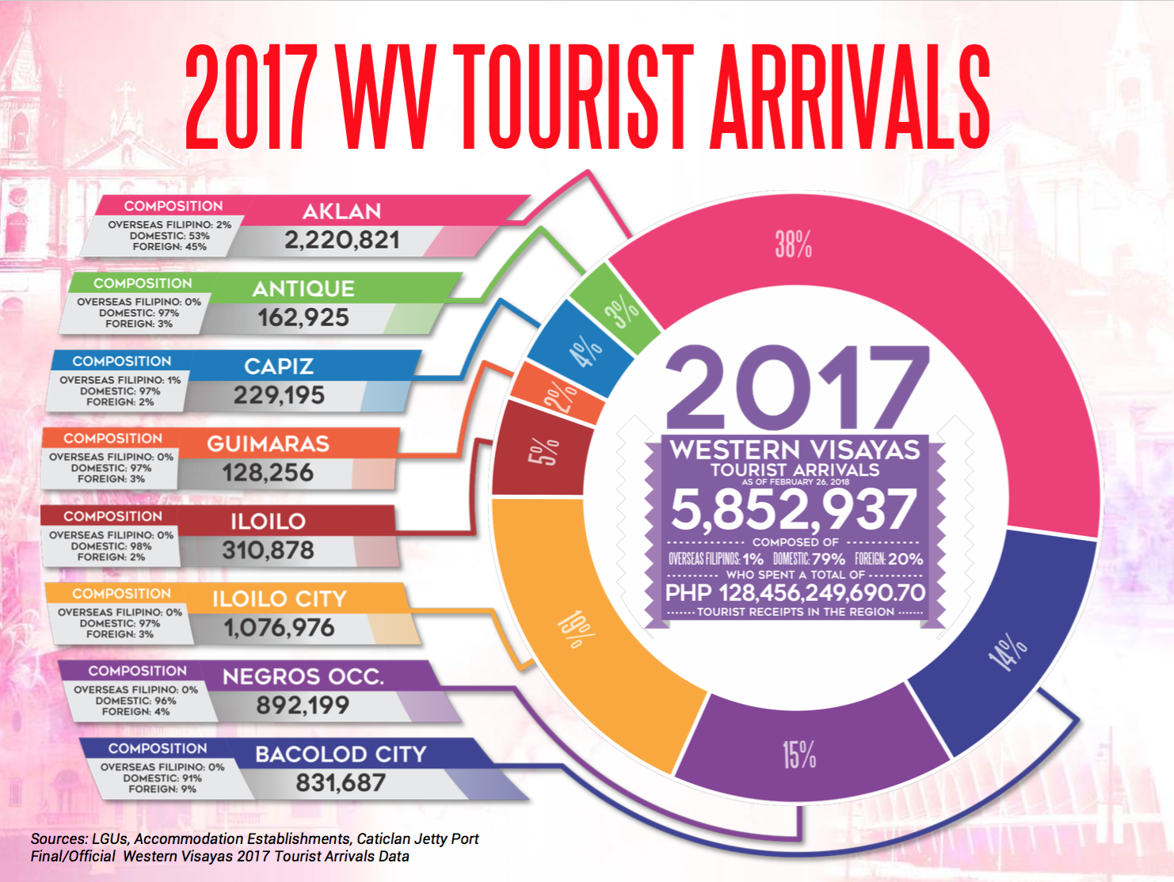

Slide 37
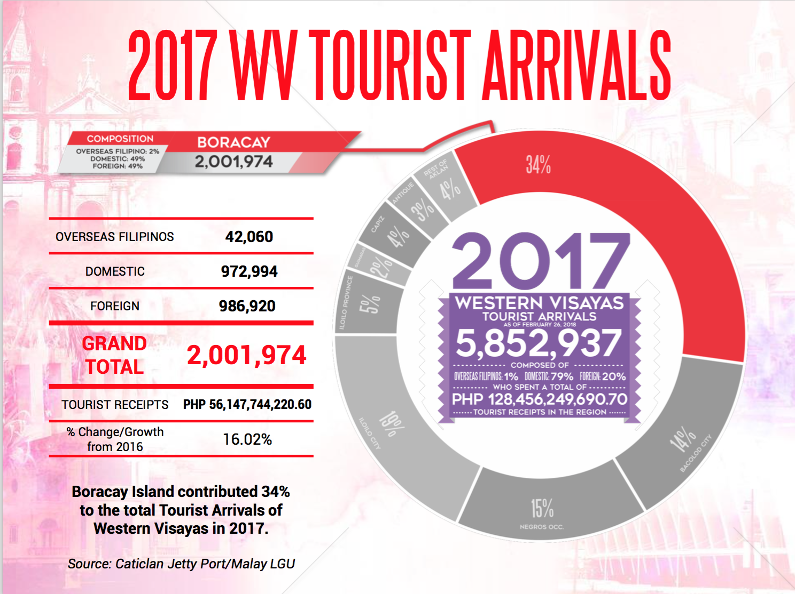

Slide 39
What is SUSTAINABLE TOURISM DEVELOPMENT?

Slide 40
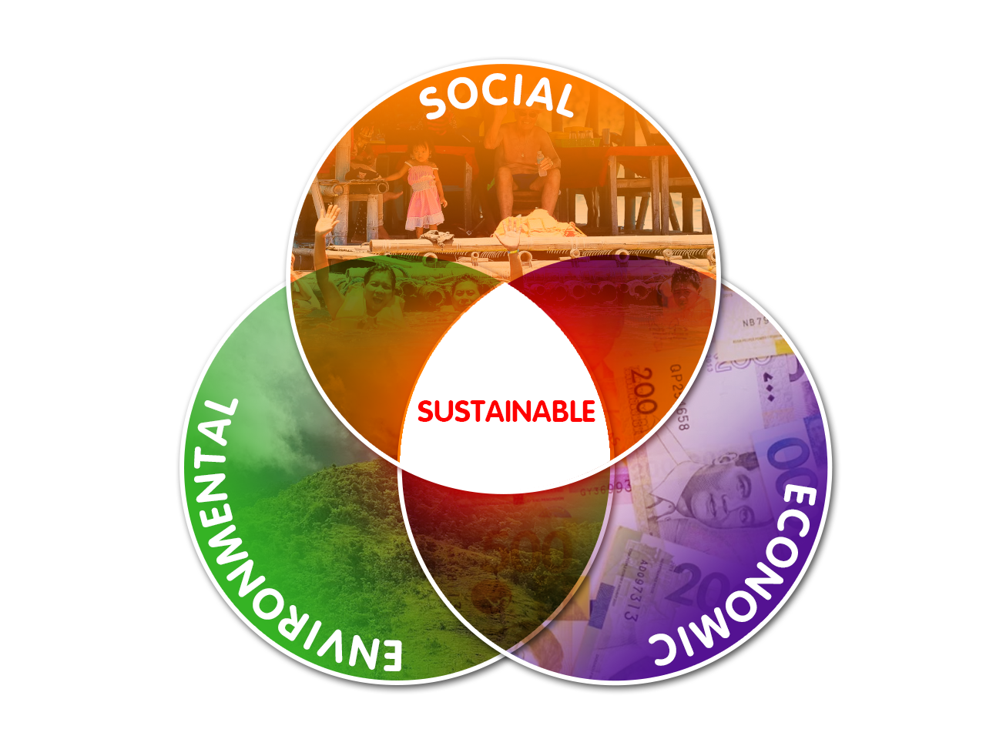
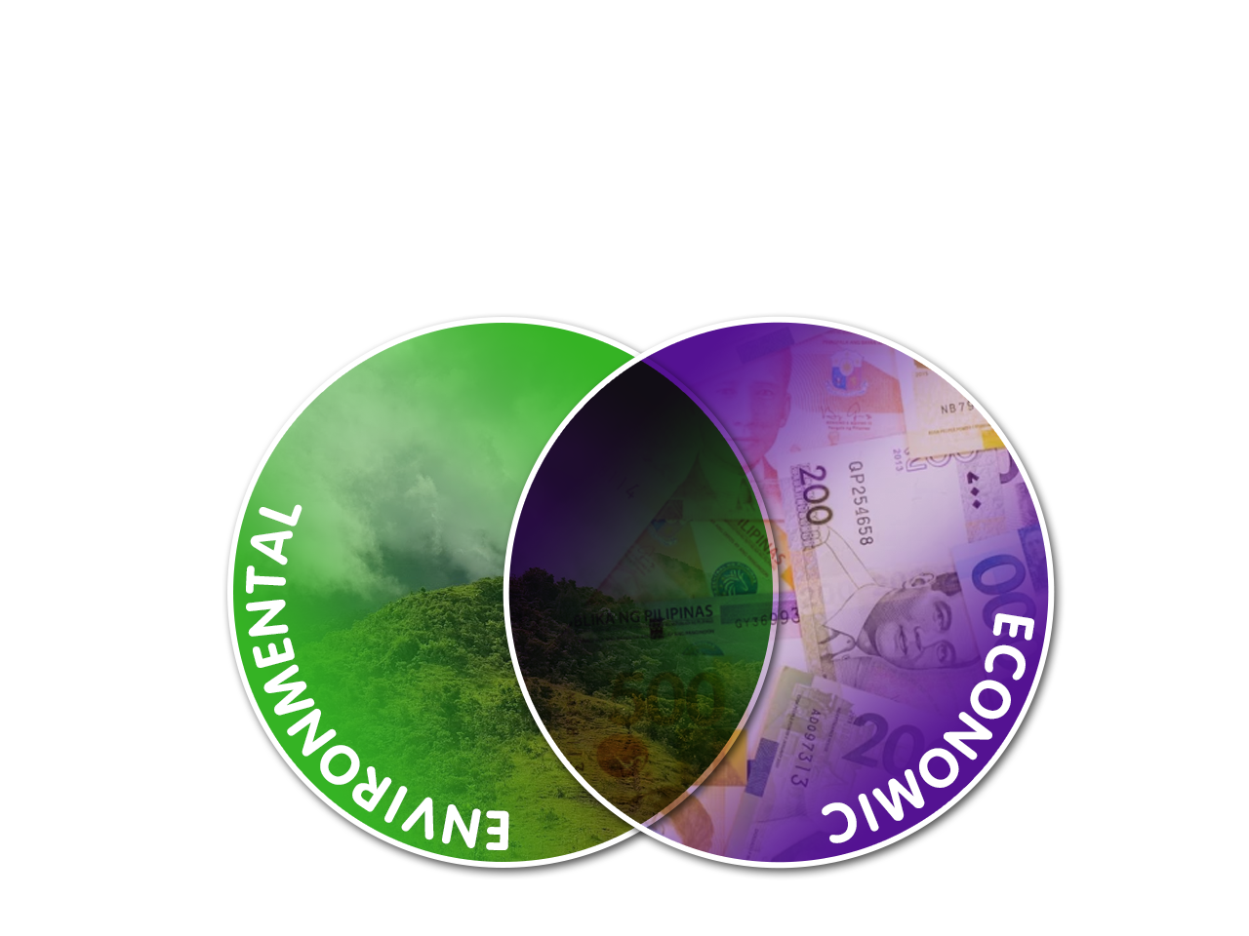
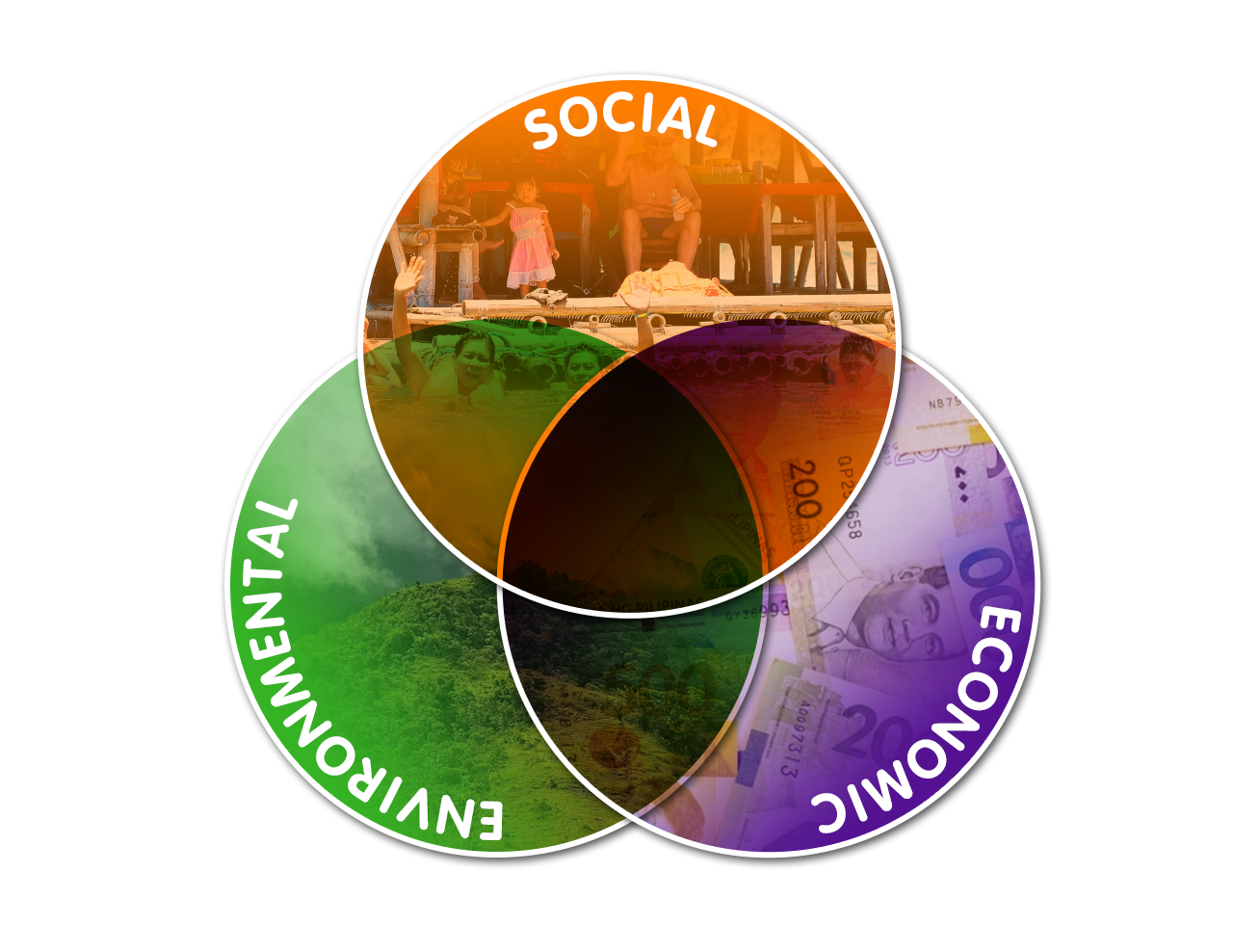
Sustainable Tourism
“Tourism that takes full account of its current and future economic, social and environmental impacts, addressing the needs of visitors, the industry, the environment and host communities"
Notes:
Sustainable Tourism, as defined by the World Tourism Organization, ““Tourism that takes full account of its current and future economic, social and environmental impacts, addressing the needs of visitors, the industry, the environment and host communities”
Sustainable Tourism can only be achieved when the three pillars are in sync – environmental sustainability, social sustainability and economic sustainability.
When a certain destination becomes popular, profit increases and so do the number of infrastructures, air and water pollution, air and sea connectivity, food consumption and new inhabitants around the area.
Let’s take a look at Western Visayas’ most visited destinations.

Slide 41
Sustainable Tourism Development
Neither the natural environment nor the socio-cultural fabric of the host communities will be impaired by the arrival of tourists.
Protecting and preserving scenic views, natural habitats and wildlife
Protect local culture and tradition, social fabric and sense of place

Slide 42
Western Visayas Vision 2022:
A SUSTAINABLE tourism-driven region
Notes:
So, why should we care about sustainable tourism? Simple – to allow 10-million tourists in Western Visayas by 2022 and let them explore our Western Visayas islands, experience culture and traditions through landmarks and old houses and commune with nature across mountain ranges in the 6 provinces of Region VI.

Slide 43
2018 WV TOURIST ARRIVALS
GRAND TOTAL | 4,955,898
Overseas Fils. | 43,095
Domestic | 4,129,072
Foreign | 783,731
Receipts (Php) | 104,858,005,358.40
% Change/Growth (2017 vs. 2018) | -15.33%
Sources: LGUs, Accommodation Establishments, Caticlan Jetty Port Final/Official Western Visayas Tourist Arrivals Data
Notes:
In 2018, 4,955,898 tourists visited Western Visayas to experience its beauty, explore its wonders and discover its islands, making it one of the most travelled regions in the Philippines.

Slide 44
2018 Top 10 Foreign Tourist Markets
PHILIPPINES |  |  | 7.13 M
Rank | Country |  | Market Share
1 |  | Korea | 22.28%
2 |  | China | 17.61%
3 |  | USA | 14.51%
4 |  | Japan | 8.86%
5 |  | Australia | 3.93%
6 |  | Taiwan | 3.38%
7 |  | Canada | 3.18%
8 |  | UK | 2.82%
9 |  | Singapore | 2.41%
10 |  | Malaysia | 2.04%
WESTERN VISAYAS* |  |  | .78 M
Rank | Country |  | Market Share
1 |  | China | 32.99%
2 |  | Korea | 27.63%
3 |  | U.S.A. | 6.30%
4 |  | Australia | 2.41%
5 |  | Russia | 2.14%
6 |  | Japan | 2.10%
7 |  | Canada | 1.98%
8 |  | UK | 1.97%
9 |  | Taiwan | 1.60%
10 |  | Germany | 1.50%

Slide 45
Notes:
Sustainable tourism development is a long-term process that requires various efforts, determination and collaboration from all sectors of the society. The very reason why efforts have been undertaken to adopt a more strategic and innovative approach in incorporating sustainability and inclusive growth in the National Tourism Development Plan 2016-2022 through MSME Development in Tourism, Gender and Women Empowerment, Cultural Offerings, Environment and Climate Change Adaptation and Risks and Crises Management Programs.

Slide 53
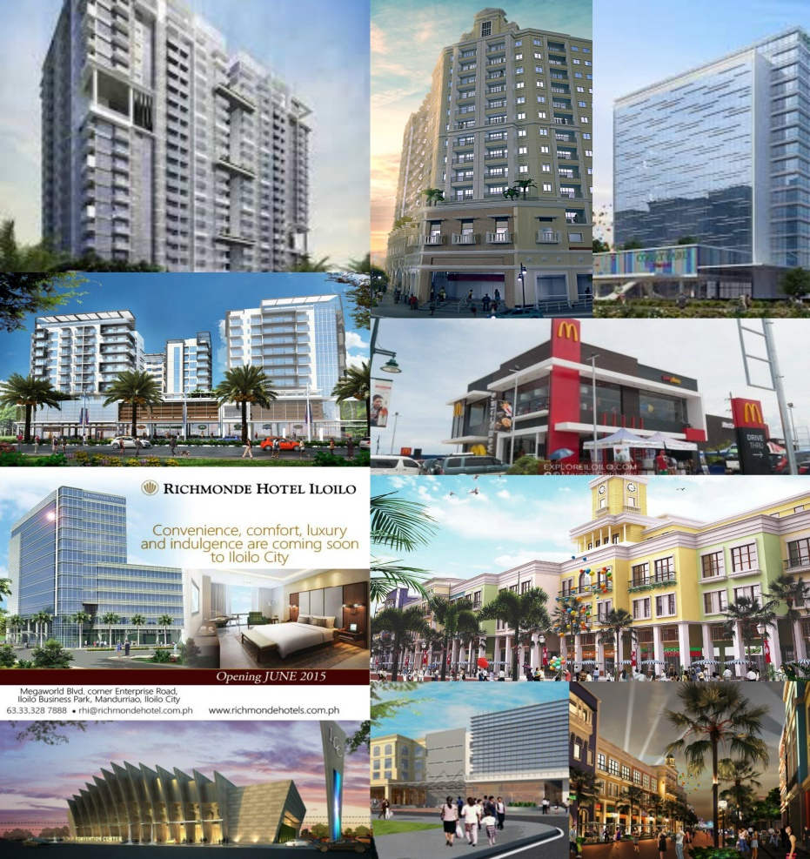
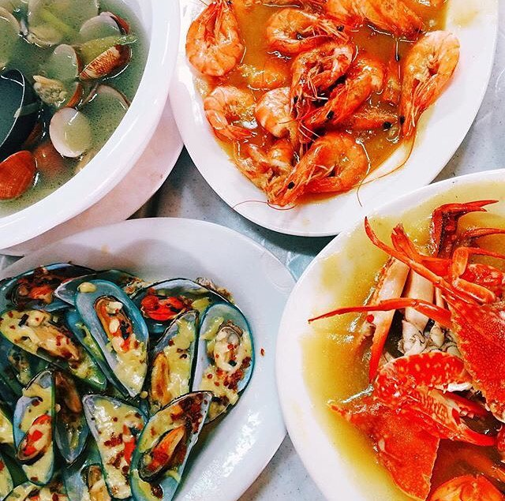
Thank you!

Slide 54
https://fp.brecorder.com/2011/06/201106201203750/
https://www.aboutuganda.com/travel/tourism
https://www.slideshare.net/elladimaiwat/government-and-private-sectors-involved-in-tourism-industry
https://www.lifeasabutterfly.com/private-sector-tourism-planning-development/ (background mo when discussing the role of private sectors)
https://slideplayer.com/slide/5010111/
https://rikachs.wordpress.com/2016/12/19/public-and-private-sector-of-travel-and-tourism/

